Slide 1


Medicaid Monthly Virtual Meeting
Jan. 15, 2026

Slide 2

Agenda
Welcome/Introduction
Medicaid Renewals and State Based Marketplace Updates
1915(i) RISE Initiative
1915(c) Community Health for Improved Lives and Development (CHILD) Waiver
Reentry Status Update
Our Healthy Kentucky Home Spotlight
Sister Agency Spotlight – Department of Public Health with Flu Season
House Resolution 1 Update

Slide 3
Medicaid Renewals and State Based Marketplace Updates

Slide 4
Medicaid Enrollment Trend
4
Notes:
Talking Points:
This slide is the most current look at Medicaid enrollment. As we shared before, this was an anticipated decline from the beginning of 2023 following the PHE unwinding. We have worked through all the initial renewals following the PHE and so now you can see that we are now hovering around 1.45 million. This has been holding steady.

Slide 5
Medicaid Renewals – December 2025
 | Individual Renewals | Medicaid Approvals | Medicaid Terminations | Pending
December | 66,573 | 59,256 | 7,003 | 311
*Numbers are based on CMS Reports.
5
Notes:
Talking Points:
- Here is a summary of Medicaid renewals for the month of December: A total of 65,573 renewals were processed, resulting in 59,256 approvals, 7,003 terminations, and 311 cases remaining pending.

Slide 6
December 2025 Renewals By Age
6
Notes:
Talking Points:
- Next, we will examine renewals broken down by age for the month of December.

Slide 7
December 2025 Child Renewals
7
Notes:
Talking Points:
Let’s take a closer look at the children’s renewal process now that flexibilities have ended. The Blue bar indicates Approved and Orange indicates Terminated. This analysis provides insight into approval and termination outcomes when comparing passive and active renewals.
Active renewals require the enrollee to take action by submitting updated information or documentation to verify continued eligibility. Failure to respond can result in termination of coverage.
Passive renewals, on the other hand, are processed automatically using existing data sources. Within passive renewals, there are two types:
Passive renewals with No Request for Information (RFI): The state is able to verify continued eligibility using existing data without needing any additional information from the household.
Passive renewals with an RFI: Although the renewal is initiated passively, the state determines that additional information is needed to confirm eligibility. In this case, a request for information is sent to the household, and failure to respond can lead to termination.
Understanding the differences between these renewal types helps clarify the trends in coverage retention and disenrollment as flexibilities have ended.

Slide 8
December 2025 Child Terminations by Reason
8
Notes:
Let us review the breakdown of termination reasons for children’s December renewals, which encompass ages 0–18. A total of 2,290 cases were terminated due to failure to return renewal paperwork or verification. An additional 402 cases were deemed ineligible for benefits, which may be attributed to factors such as income exceeding program limits, relocation out of state, access to alternative insurance coverage, or other eligibility changes. Finally, 231 cases were terminated for miscellaneous reasons such as client request.

Slide 9
Stay Covered: Renew Your Medicaid!
Every 12 months Medicaid members will go through a renewal process to make sure they are still eligible for coverage. Keep your information updated!
A renewal notice is sent at least 45 days before the due date with instructions and a deadline to submit required information. A reminder is sent about 15 days before due date.
You can check your renewal month by logging into the Kynect portal or calling the Kynect line. kynect.ky.gov or call 855-4kynect (855-459-6328). Providers also have access to the renewal date in KYHealthNet.
Send in requested information right away to avoid losing coverage! If coverage is terminated, reach out within 90 days to submit information to reactivate the case. If outside the 90 days will need to reapply.
9

Slide 10

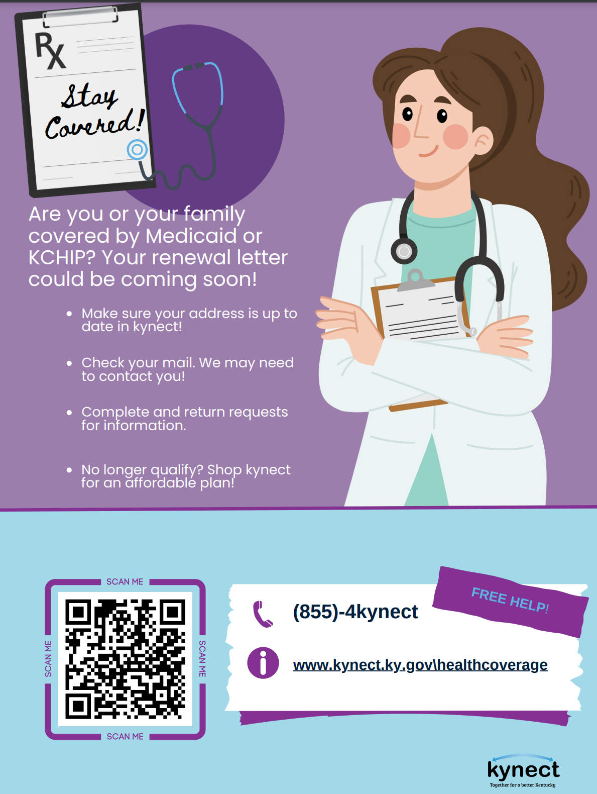
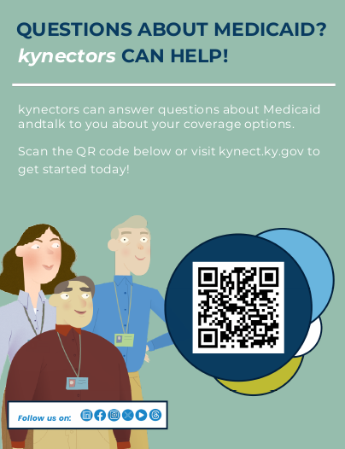
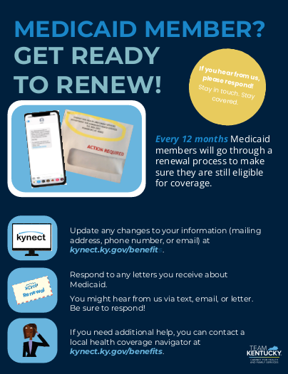
Help us get the message out! Communications materials available to support members!
How to Apply
Materials for Offices
Get help from kynectors
Renewals
10
https://medicaidrenewals.ky.gov

Slide 11
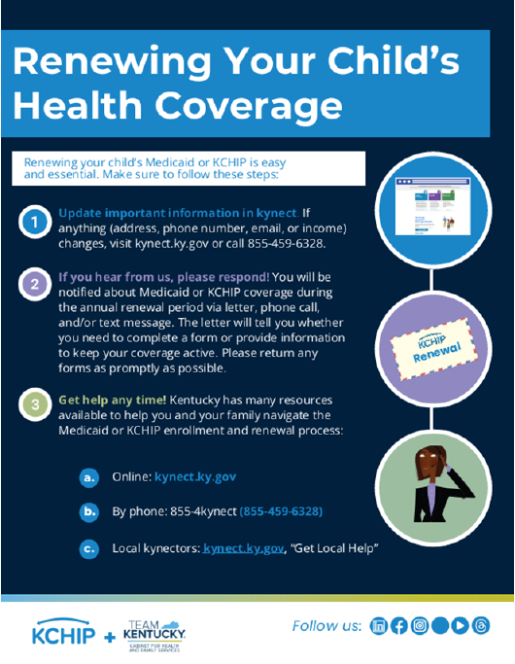
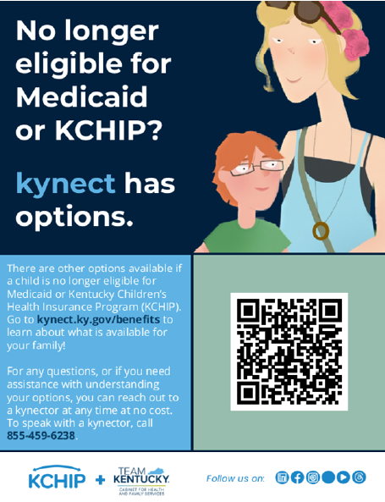

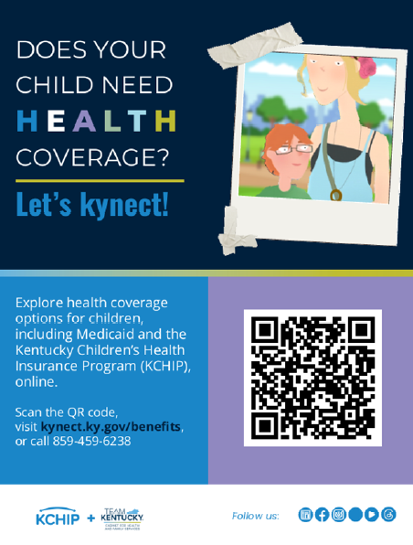
Spread the word about Renewals for Children too! Materials are available to help families stay in the know!
Renewing Child Coverage
Health Coverage Options
Get help from kynectors
Use kynect
https://kidshealth.ky.gov/Documents/Child%20Renewal%20Communication%20Packet_April%202025.pdf
11

Slide 12
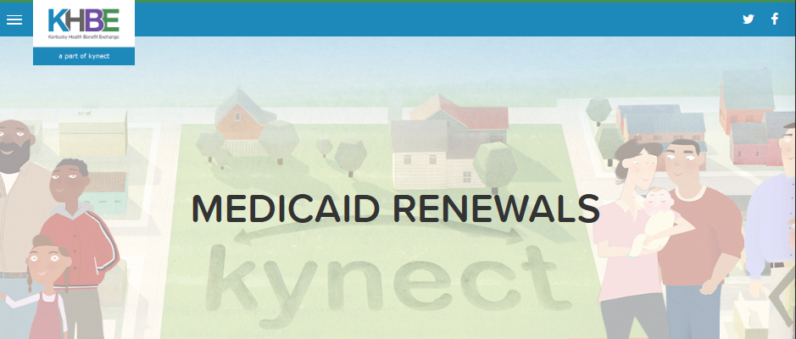
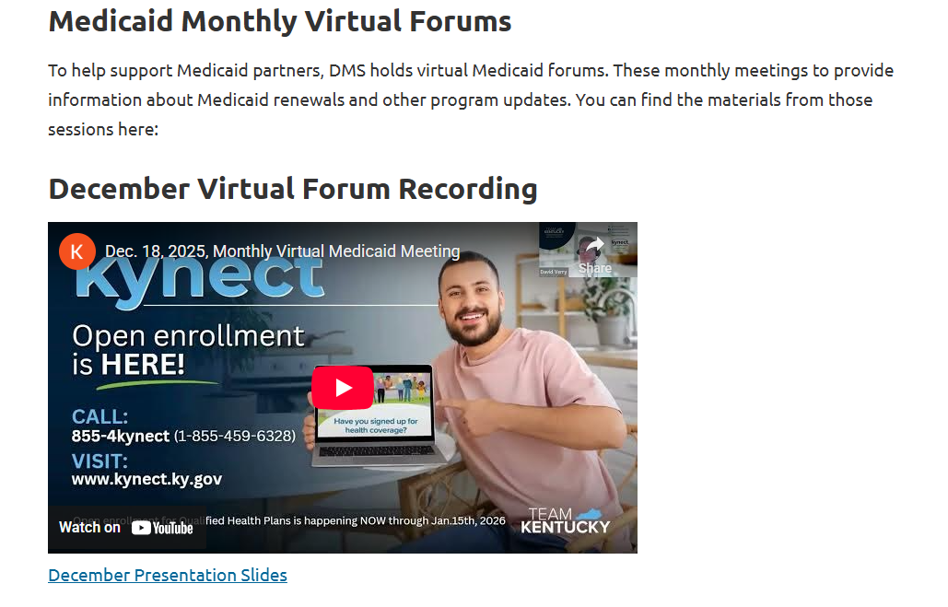
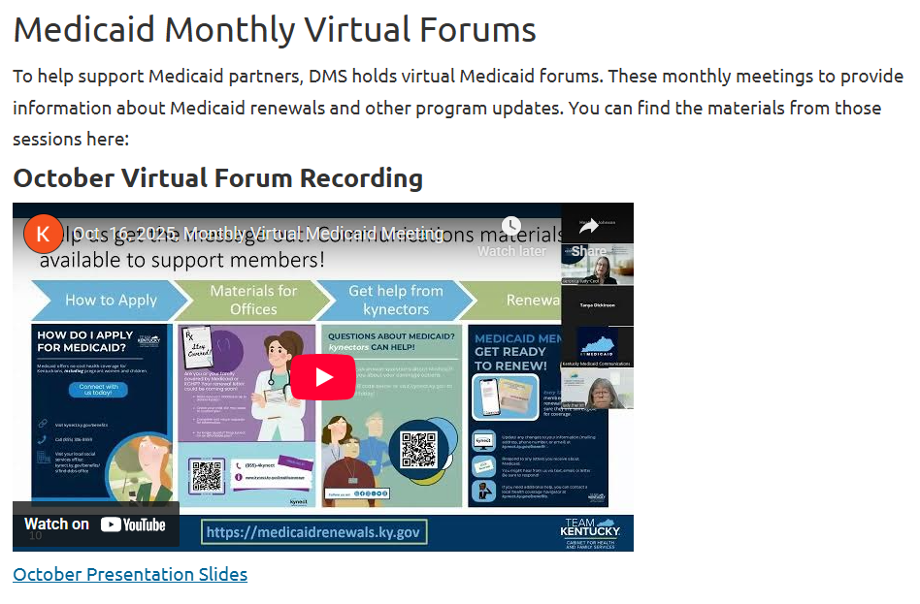
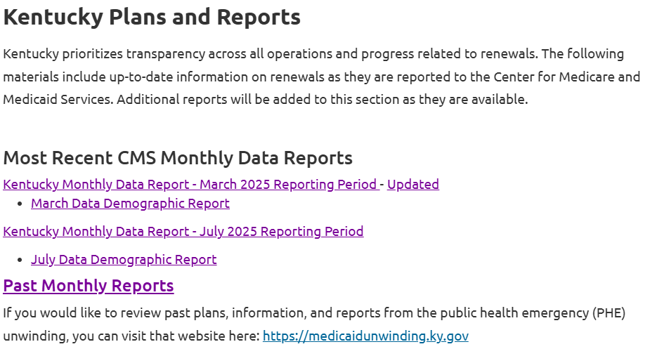
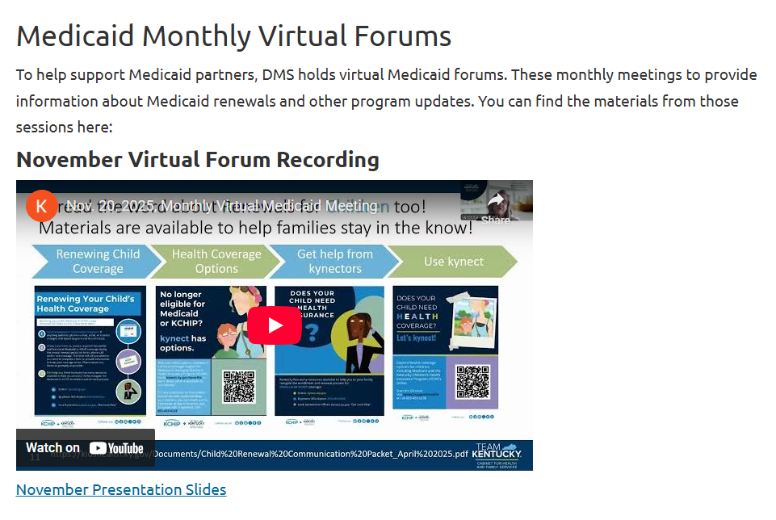
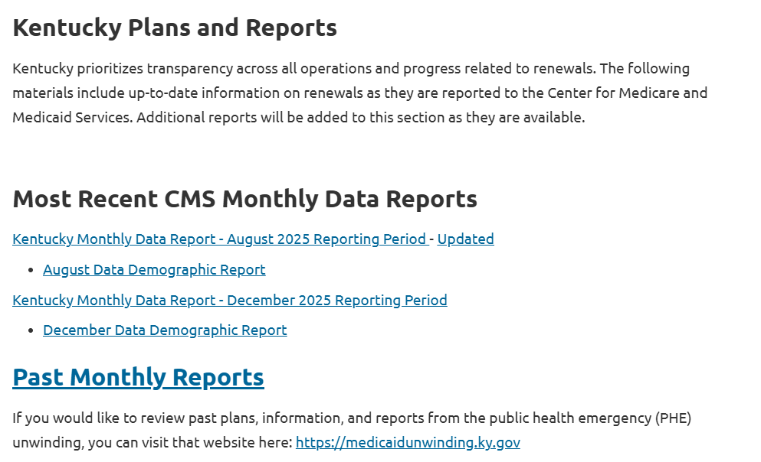
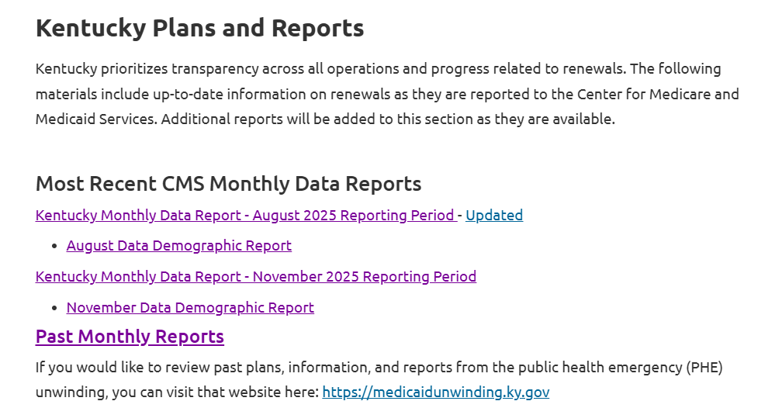
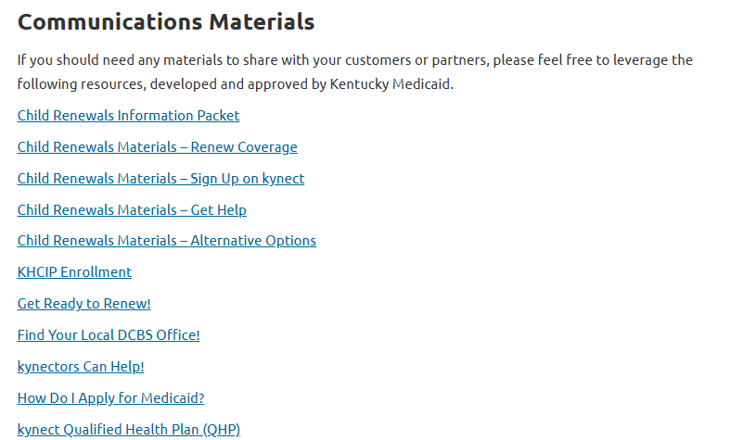
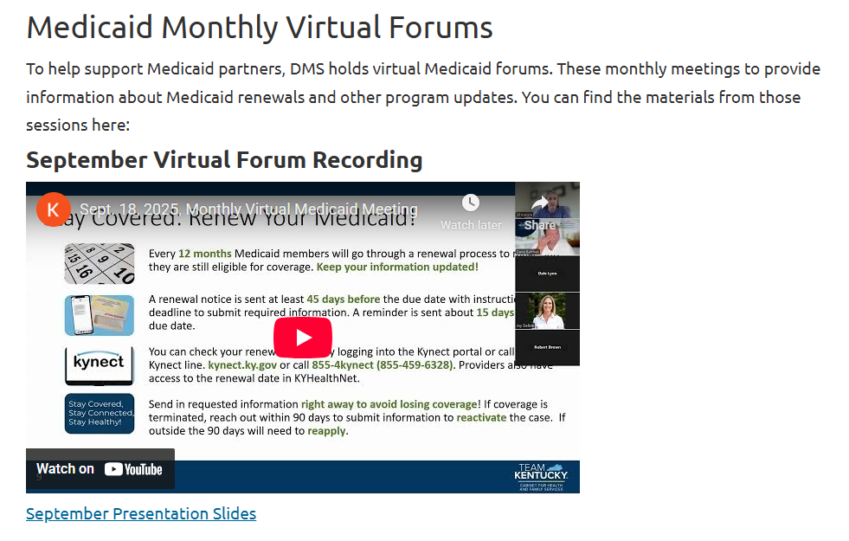
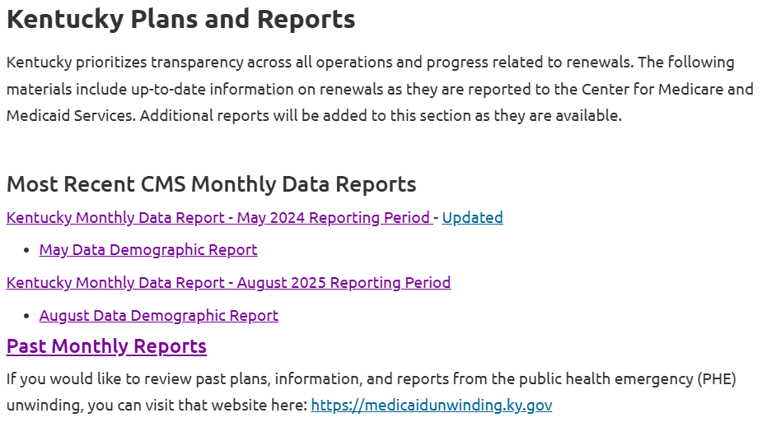
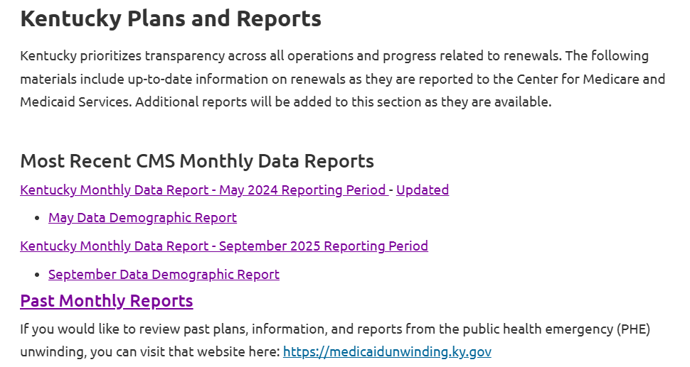
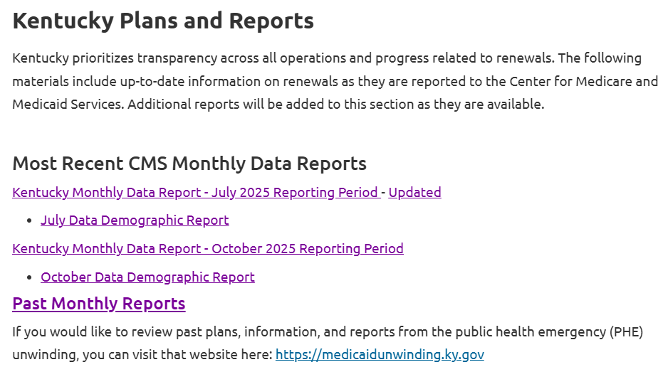
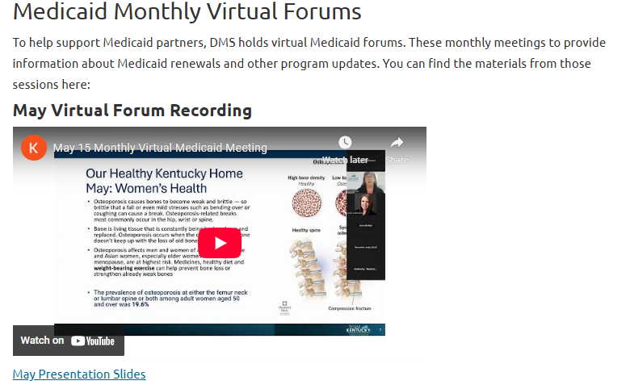
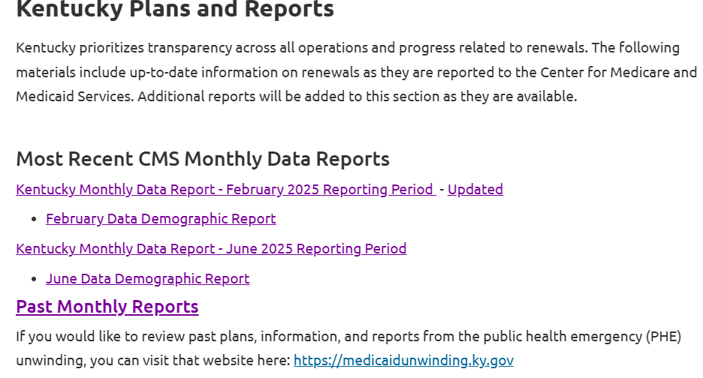
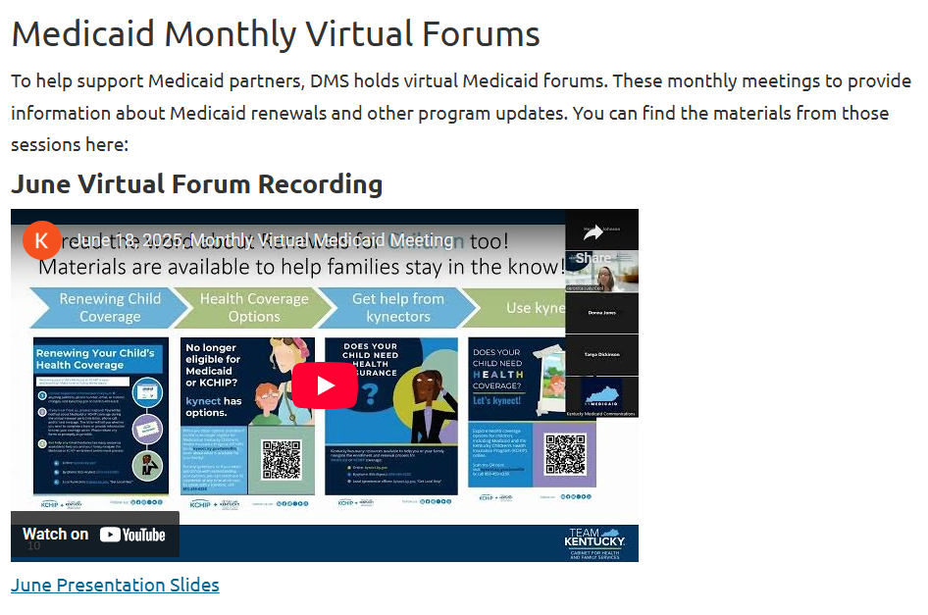
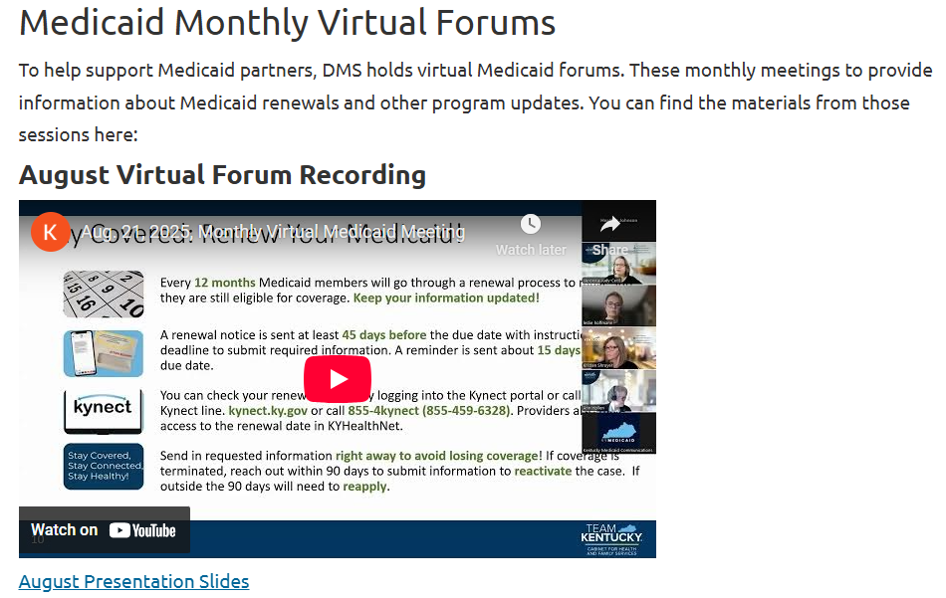
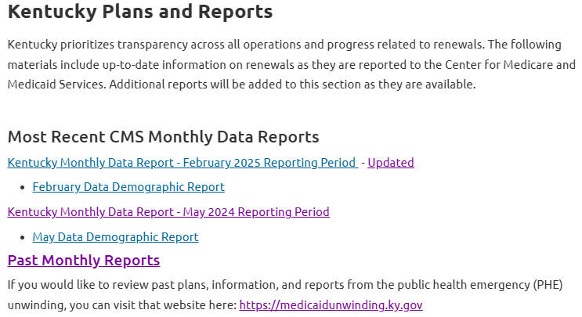
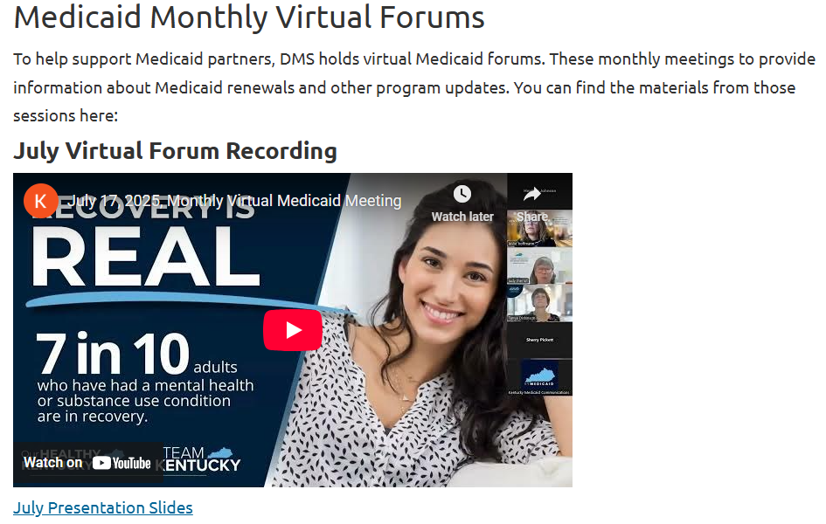
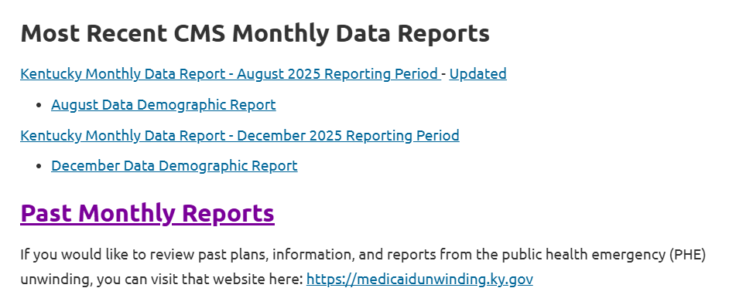
KY Medicaid Website Resources
https://medicaidrenewals.ky.gov
Monthly Forum Session Information
KY Reports
FAQs
Medicaid Member Information
Medicaid Provider Information
Communication Materials
12
Notes:
Talking Points:
We also always remind folks that there is a lot of information on that website!
There are fliers for navigating the renewal process, helping members with things like ID proofing for kynect accounts, and materials for providers and kynectors to download and use.
Anyone should feel free to take these and use them to help others learn more.
Here is a snapshot of the website. It has the reports, like we mentioned, the fliers, and additional information pieces that can be useful!

Slide 13
State Based Marketplace Updates
Open Enrollment ends January 15th at midnight local time. Comparatively, over 89,000 people have enrolled for 2026 including those automatically re-enrolled and people enrolling for the first time. Around 14,000 are new enrollees. To date, around 10,700 have cancelled their 2026 coverage. (More have newly enrolled than cancelled for 2026) Around 16,000 people have changed their plans—mostly from Silver to the less expensive Bronze. Around 7,500 of the 11,000 members who lost CareSource (left the KY Marketplace) for 2026 have come back and enrolled in a new plan from a different carrier The Kentucky Health Benefit Exchange stands ready should state or federal policies change regarding subsidies

Slide 14
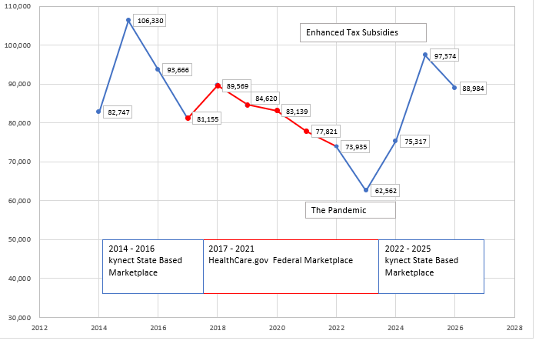
Kentuckians Enrolled in Qualified Health Plans

Slide 15
1915(i) RISE Initiative

Slide 16

~1915(i) RISE Initiative~
New Medicaid benefit under Kentucky’s 1915(i) State Plan
Designed for Medicaid-eligible adults (18+) with Serious Mental Illness (SMI), with or without a co-occurring Substance Use Disorder Brings 10 essential Home and Community-Based Support (HCBS) services to participants in their community

Slide 17
1915(i) RISE Initiative Recent Developments:
After securing the full complement of 10 services within the counties served, we are pleased to announce that Community Mental Health Center (CMHC) Regions 2 (Pennyroyal Regional Center) and 12 (Kentucky River Community Care) will begin accepting 1915(i) RISE Participant referrals 1/15/2026! See available providers at https://dbhdid.ky.gov/providerdirectory
Instructions for referring participants to the 1915(i) RISE Initiative may be found on the attached 1915(i) RISE Referral Submission Form

Slide 18
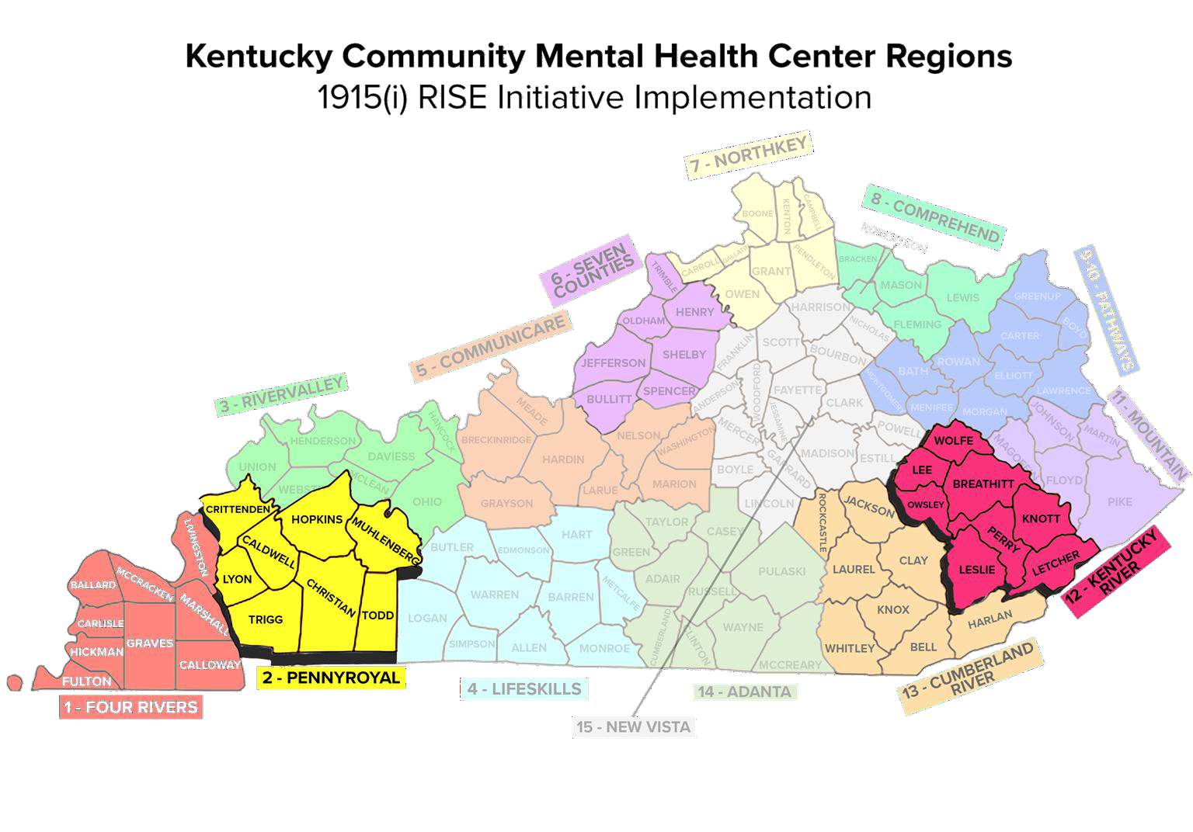

Slide 19
10 certified providers, with 80+ more currently somewhere in the application/review process.
You can track as providers come on-line at our Provider Directory, https://dbhdid.ky.gov/providerdirectory
Over 200 potential providers have registered for our “Office Hours” series on Mondays, 3:00-4:00pm (ET). A quick Zoom registration allows you to attend any or all future meetings.

Slide 20
1915(c) Community Health for Improved Lives and Development (CHILD) Waiver

Slide 21
What is the 1915(c) CHILD Waiver?
Community Health for Improved Lives and Development
The CHILD Waiver is a new Kentucky Medicaid program designed to help Kentucky children and youth with significant behavioral health or developmental challenges get the services they need, while staying at home, in school, and in their communities.
Serving Children & Youth with Most Complex Needs
Focused for children and youth stepping out of acute inpatient care or at risk of out-of-home placement due requiring intensive behavioral health and residential supports.
CHILD waiver includes clinical therapeutic services designed to foster a step-down approach, coming from the highest level of care to return to home and the community.

Slide 22
Who does the 1915(c) CHILD Waiver Help?
Children and Youth
Under age 21,
With significant behavioral health or developmental needs.
Kentucky children and youth who:
Need a level of care like what would be provided in an inpatient facility, intermediate care facility for individuals with intellectual disabilities (ICF/IID), or hospital.
Can be safely supported at home or in the community with the right services.

Slide 23
Who does the 1915(c) CHILD Waiver Help?
Enrollment is targeted to those who have exhausted supports and services enabling them to remain in the community and:
Are or at risk of being unhoused
Have a history of at least two different foster care placements
Have at least five contacts with law enforcement
Is discharging from an institution in the next 45 calendar days

Slide 24
CHILD Waiver Services
Case Management
Respite
Community Living Supports
Environmental and Minor Home Modifications
Clinical Therapeutic Services
Supervised Residential Care

Slide 25
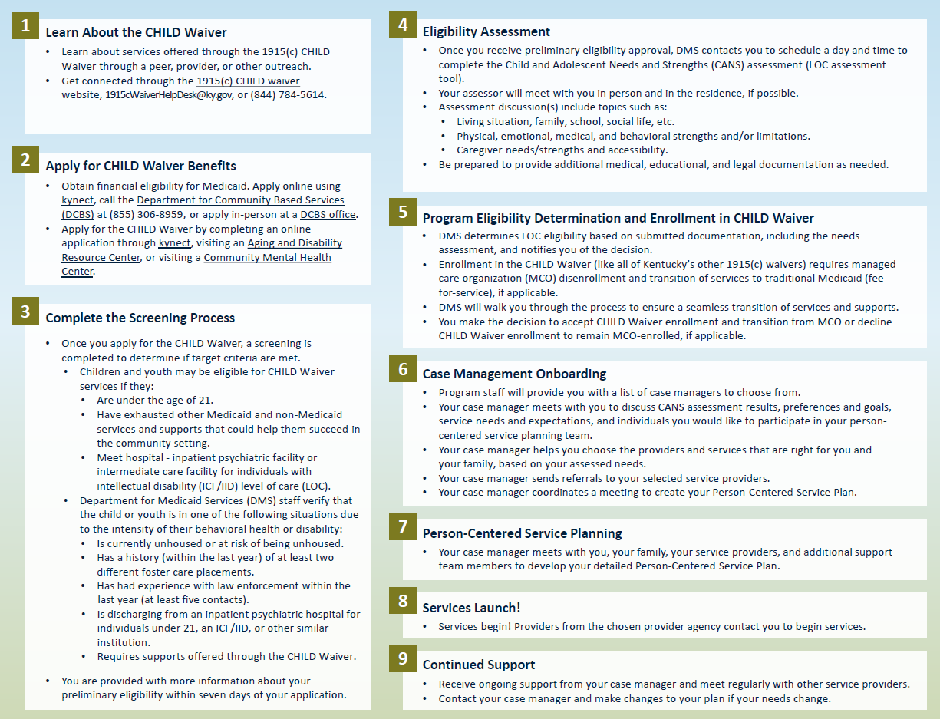
Participant Application Process

Slide 26
Current Updates
All systems went live on January 1, 2026
Provider outreach, enrollment and training is underway!
Participant applications are being accepted!
The first CHILD Waiver provider has been certified!
Currently six (6) additional providers in the certification process
The first CHILD Waiver participant has been approved for Level of Care!

Slide 27
Provider Resources
1915c Waiver Helpdesk: 1915cwaiverhelpdesk@ky.gov or 844-784-5614
Cabinet for Health and Family Services Website: https://www.chfs.ky.gov
CHILD Waiver Website: chfs.ky.gov/agencies/dms/dca/Pages/child.aspx
CHILD Waiver Reimbursement: Fee Schedules - Cabinet for Health and Family Services
Regulations:
The 1915(c) CHILD regulations are currently under review and awaiting approval
907 KAR 2:720: CHILD Waiver Program Requirements
907 KAR 2:725 CHILD Waiver Reimbursement
Notes:
​

Slide 28
Reentry Status Update

Slide 29
Our Healthy Kentucky Home Spotlight

Slide 30



Year 2
January 2026:
We continue to promote simple, healthy lifestyle changes with a special focus on helpful health and wellness programs available to all Kentuckians.

Slide 31

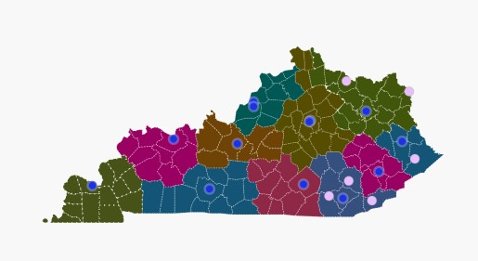
The Office for Children with Special Health Care Needs: OCSHCN
Multispecialty Direct Care Clinics
Supplemental services such as Care Management and therapy
Family to Family Health Information Center
State Newborn Hearing screening program

Slide 32
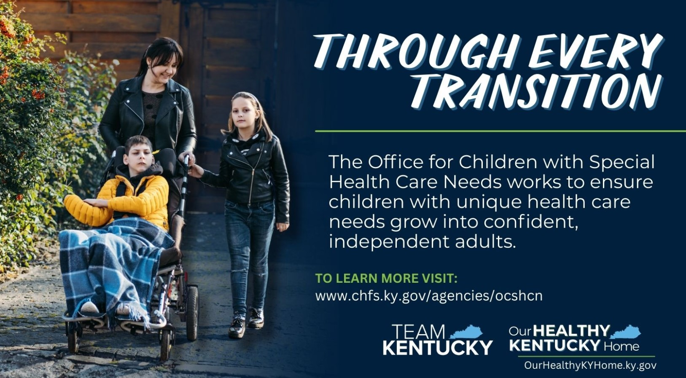

Slide 33


Slide 34
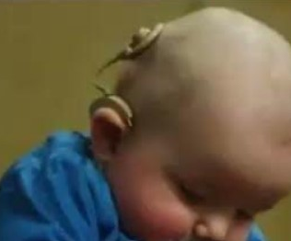
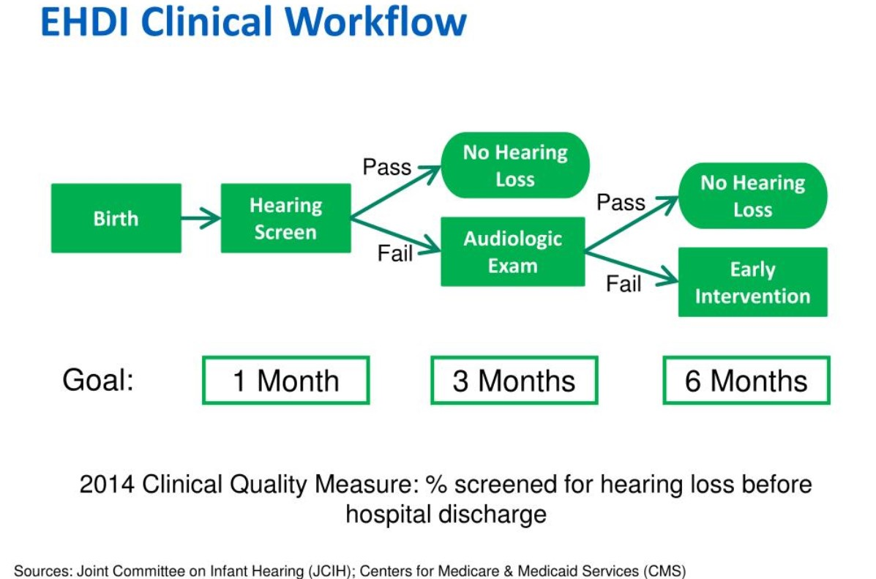


Slide 35


Slide 36


Slide 37


Slide 38
Resources
The Office for Children with Special Health Care Needs (OCSHCN)​
Find an OCSHCN Regional Office
OCSHCN Services Brochure
The Commission on the Deaf and Hard of Hearing
Early Hearing Detection and Intervention (EHDI)
Kentucky Early Intervention System

Slide 39
Sister Agency Spotlight – Department of Public Health with Flu Season

Slide 40
Spotlight on Vaccines and Influenza Kathleen Winter, PhD, MPH
January 15, 2026

Slide 41
KDPH vaccine letter 1/7/2026
KDPH continues to recommend that health care providers follow childhood immunization schedules published by the American Academy of Pediatrics and the American Academy of Family Physicians and that families consult with their health care providers to make informed decisions about their health.
All vaccines recommended by CDC as of December 31, 2025, remain covered by the Vaccines for Children Program and by insurance plans subject to the Affordable Care Act, including Medicaid, without cost sharing.
Kentucky’s school and childcare immunization requirements remain unchanged by any federal action to date, including the recent federal reorganization of the CDC schedule. These state requirements are established in state law and in regulations, including 902 KAR 2:060.

Slide 42
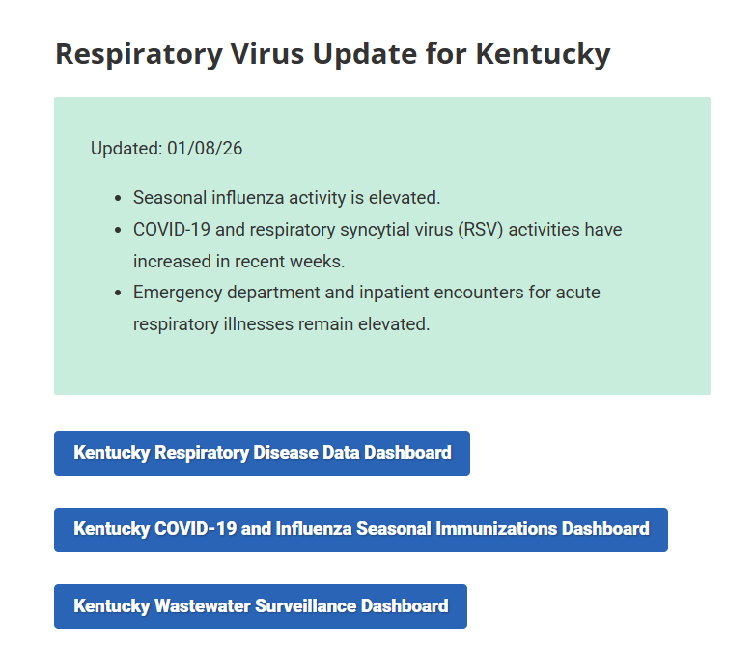
www.coveryourcough.ky.gov

Slide 43
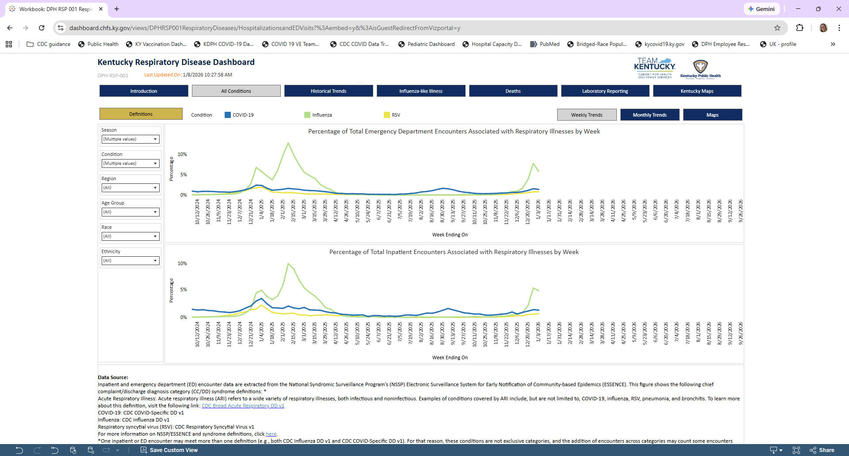
https://dashboard.chfs.ky.gov/views/DPHRSP001RespiratoryDiseases/HospitalizationsandEDVisits?%3Aembed=y&%3AisGuestRedirectFromVizportal=y

Slide 44
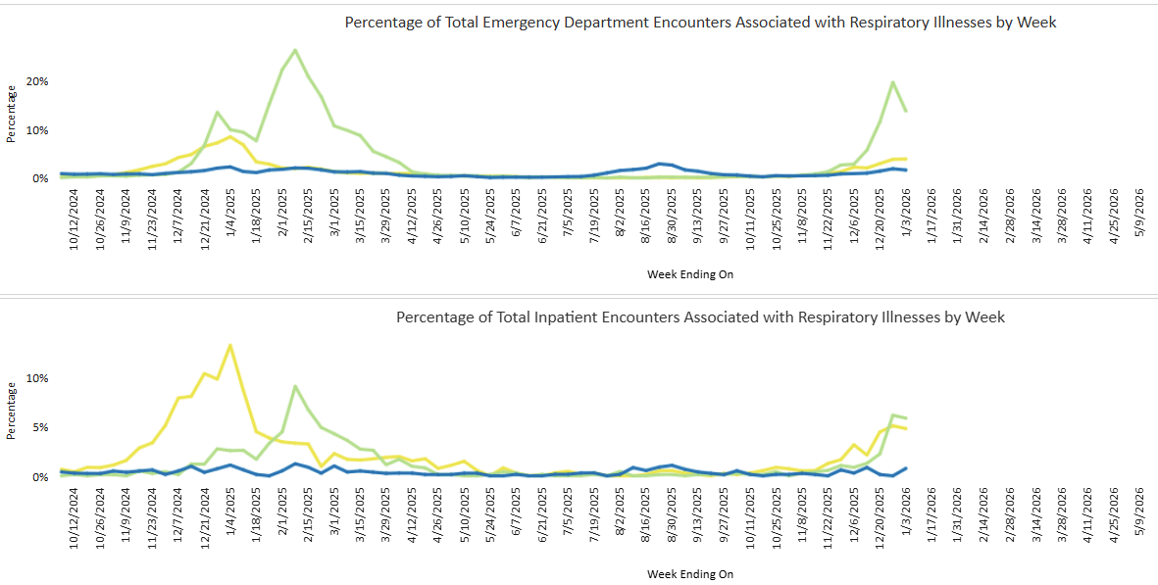
Pediatric cases only (<18y)
https://dashboard.chfs.ky.gov/views/DPHRSP001RespiratoryDiseases/HospitalizationsandEDVisits?%3Aembed=y&%3AisGuestRedirectFromVizportal=y

Slide 45
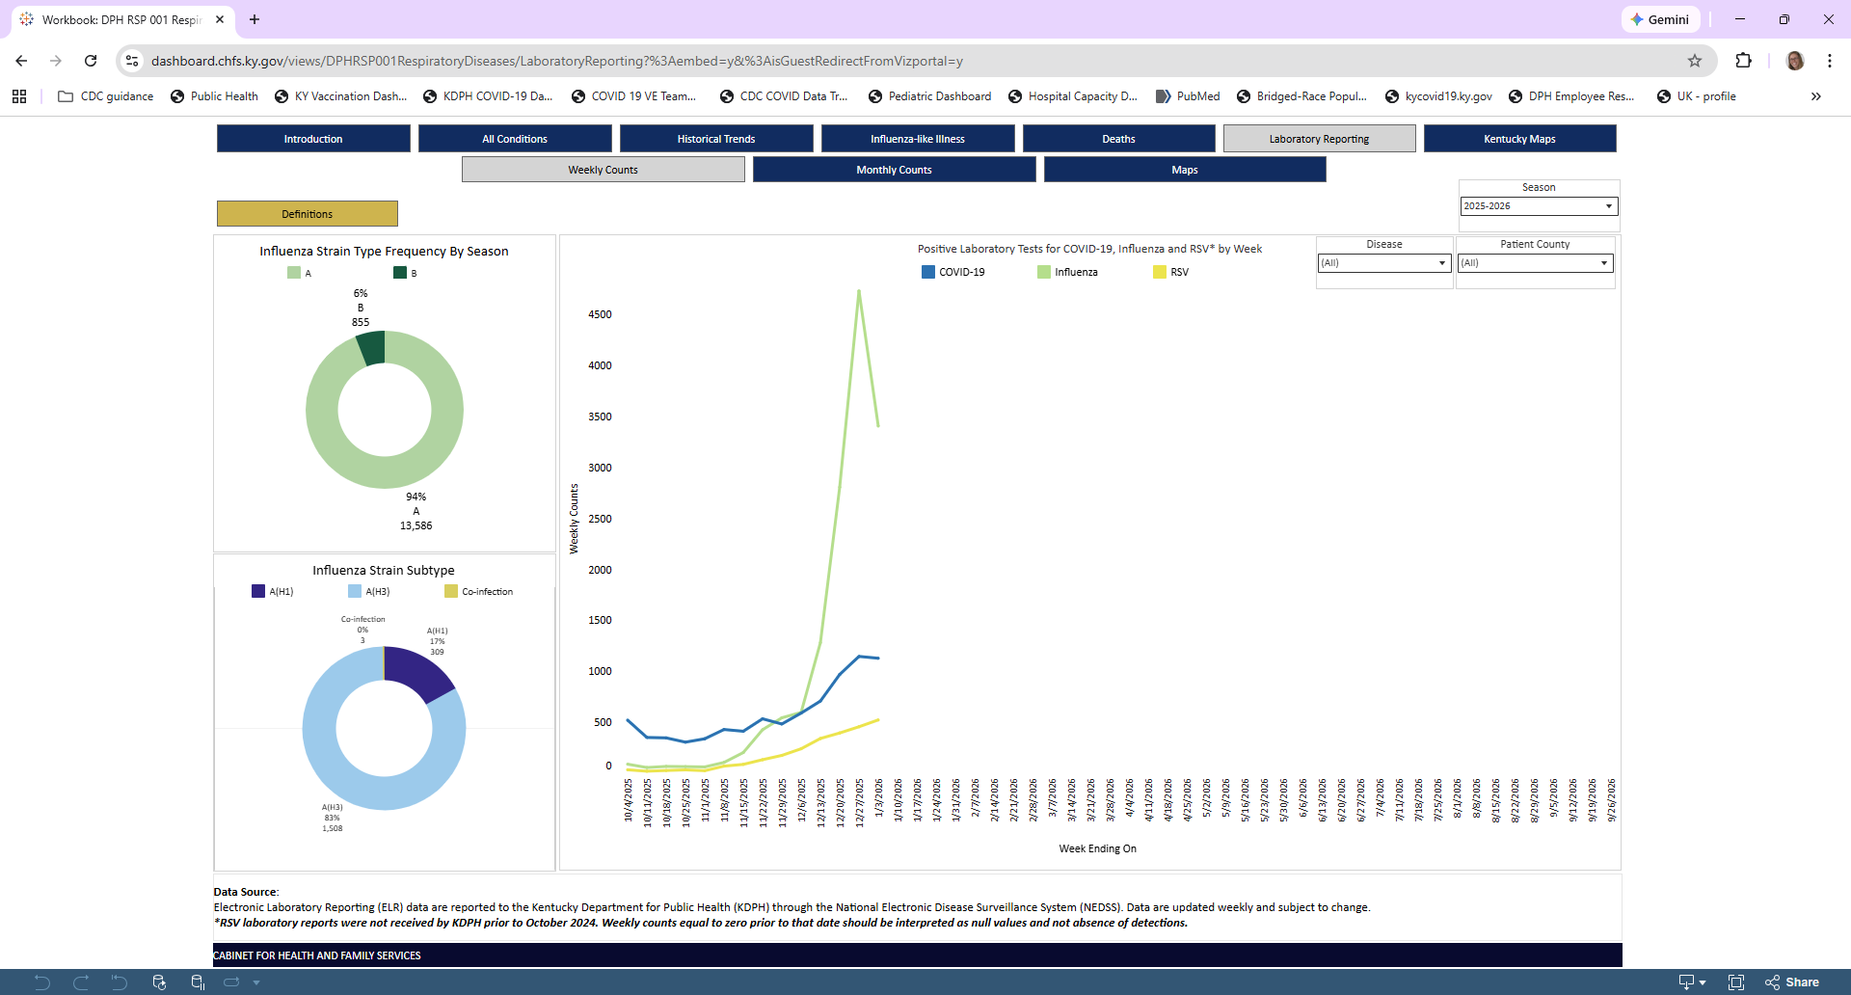
Influenza strains
Nearly all typed samples are flu A(H3)
Likely subclade K

Slide 46
Influenza A(H3N2) Subclade K
Emerged in the southern hemisphere last summer, too late to be included in this season’s vaccine formulation.
Early speculation that this season’s vaccines would not work well against this strain due to the “mismatch”.
However, preliminary data from the UK and USA indicate that there is cross protection with this season’s vaccine.
70-75% for children and 30-40% for adults
H3N2 predominant flu seasons typically associated with more hospitalizations and deaths in older adults.

Slide 47
Influenza Vaccine Uptake (as of 1/3/26)
Adults 18+ years:
43.1% Nationally (41.6%-44.6%)
39.8% Kentucky (35.1%-44.5%)
Children 6m-17 years:
42.5% Nationally (40.4%-44.7%)
43.1% Kentucky (29.5-56.7%)
Influenza Vaccination Coverage and Intent for Vaccination, Adults 18 Years and Older, United States | FluVaxView | CDC
Influenza Vaccination Coverage, Children 6 months through 17 years, United States | FluVaxView | CDC

Slide 48
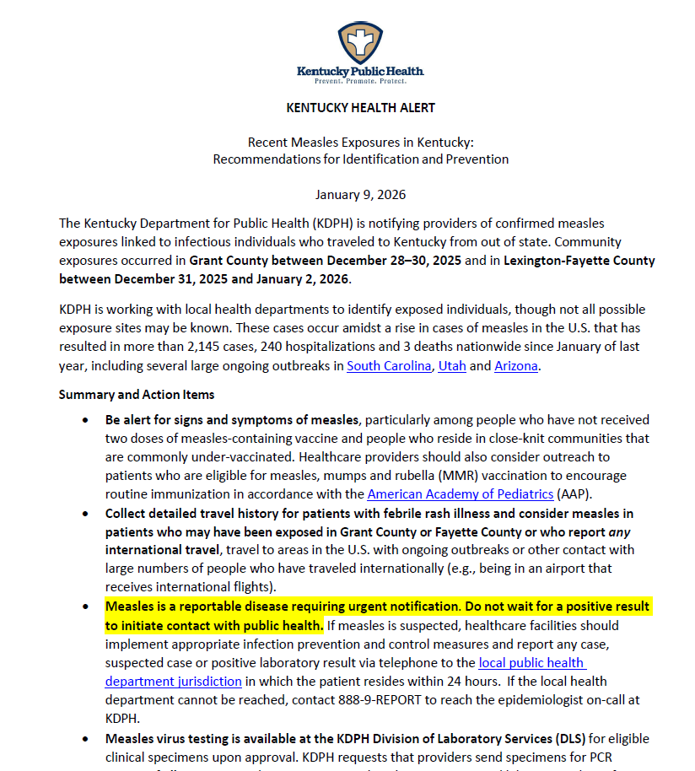
Measles Alert
Recent exposures in northern and central KY due to out of state residents traveling to KY
Large ongoing outbreaks in South Carolina, Utah, and Arizona
More cases in USA in 2025 than any year since elimination

Slide 49
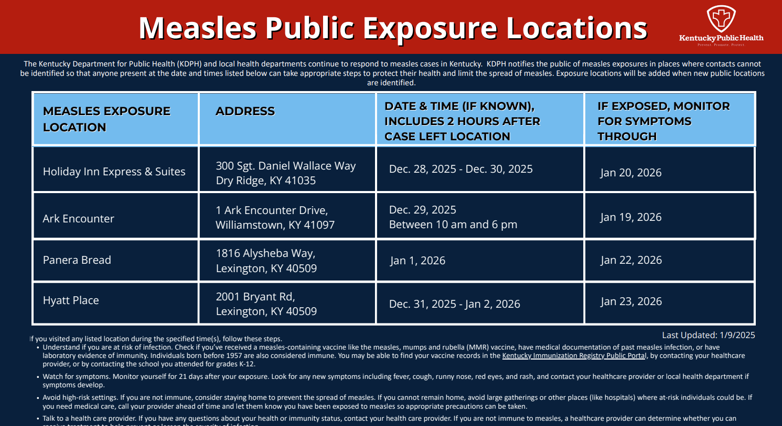
MeaslesExposureChart

Slide 50
Thank you!
Acknowledgements:
Kentucky Immunization Branch
Kentucky Local Health Departments
Kathleen Winter, PhD, MPH
State Epidemiologist / Director
Division of Epidemiology and Health Planning
Kentucky Department for Public Health
Kathleen.winter@ky.gov

Slide 51
House Resolution 1

Slide 52
KY Rural Health Transformation Program Initiatives
Five Initiatives
Strategic Goal
Use of Funds
 | Rural Community Hubs for Chronic Care Innovation Reduce obesity and diabetes rate through evidence-based, community-led strategies focused on upstream prevention | Make Rural America Healthy Again, Tech Innovation | A, C, D, E, F, G, I, J, K
 | PoWERing Maternal and Infant Health: Community-based Teams Increase timely perinatal care in maternity care deserts through coordinated, telehealth-enabled teams | Sustainable Access | A, B, C, D, E, F, G, H, I, K
 | Rapid Response to Recovery: EmPATH Model, Mobile Crisis and Telehealth Expand integrated, technology-enabled crisis care from community response to long-term support | Innovative Care | D, E, F, G, H, I, J, K
 | Rooted in Health: Rural Dental Access Program Improve rural access to preventive dental care and treatment through expanded training and mobile portable services | Workforce Development | A, B, D, E, F, G, I, J, K
 | From Crisis to Care: Integrated EMS and Trauma Response Strengthen capabilities and capacity for pre-hospital care and in-place interventions | Sustainable Access | A, B, D, E, F, G, K
1
2
3
4
5

Slide 53
Rural Health Transformation Project Website
Updates about the Rural Health Transformation Project (RHTP) will be posted on the website:
https://ruralhealthplan.ky.gov
The website currently features:
Kentucky’s RHTP application,
Kentucky’s RHTP plan and program information,
Information about rural health in Kentucky, and
Contact information.
To contact the RHTP Team, please email:
ruralhealthplan@ky.gov

Slide 54
Eligibility Changes
October 1, 2026: Eligibility changes for immigrants.
December 31, 2026: Work/Community engagement requirements and 6-month redeterminations for expansion population.
January 1, 2027: Retroactive coverage limits of one month for expansion and two months for all other groups.
October 1, 2028: Cost sharing for expansion adults.

Slide 55

55

Slide 56



Open call for topics of interest!
What would you like to hear more about from the Cabinet?
Contact CHFS Listens at CHFS.Listens@ky.gov or call 1-833-372-004.

